Slide 1
Introduction to Computer Science
Computer Basics

Slide 2
Objectives
Define terminology.
Computer
Algorithm
The von Neumann model.
Describe the three components of a computer: hardware, data, and software.
Give a short history of computers.

Slide 3
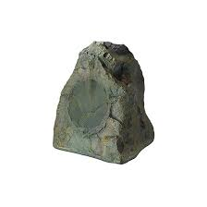
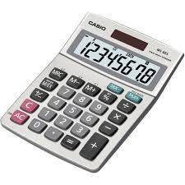
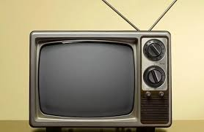
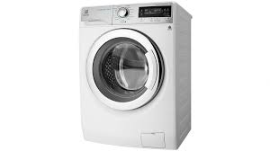
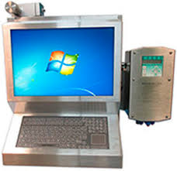
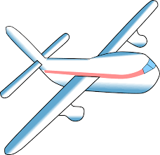
Which one is the computer?
Rock Calculator Television
Modern Airplane Washing Machine
Computer Workstation

Slide 4
Is a rock a computer?
Does not act or process
Takes no input and produces no output
Computers must be able to handle input and output

Slide 5
Is a washing machine a computer?
Input: dirty clothes
Output: clean clothes
Does not handle information
Computers input and output information

Slide 6
Is a television set a computer?
Input: information from cables or radio waves
Output: information as sound and picture
Does not process information
Computers process information by computing new results and answering queries

Slide 7
Is a modern airplane a computer?
Input: information from radio waves
Output: manipulations to the airplane
Can only handle specific information necessary for flight control
Computers are general purpose because they can perform many different tasks

Slide 8
Is an ordinary calculator a computer?
Input: numbers and mathematical operations
Output: answer
Handles any numeric task
Cannot remember which buttons are pressed
Computers are programmable so they can remember sequences of operations

Slide 9
Definition of a Computer
A general purpose,
Programmable,
Information processor
With input and output

Slide 10
Computing Agents
Definition of computers does not cover all that computer scientists study
Broader class of objects and methods – computing agents
Have some or all of the characteristics of a computer

Slide 11
Specialized Computing Devices and Information Appliances
Devices limited by set of operations or programmability
Calculators limited to operations described by their buttons
Global Positioning System (GPS) calculates latitude and longitude from satellite signals
Cell phone allows one to surf the web
Information appliances – performs a single job well
Notes:
Calculators become more powerful with each additional button

Slide 12
Embedded computers and robots
Machines with full-fledged computers inside
Washing machines, airplanes, ATMs, etc.
Such machines require highly reliable, predictable computer programs
All physical mechanisms controlled by computers are robotic devices
Restrict definition to machines that are general purpose and programmable
Robotic arm or cart

Slide 13
What is a computer?
Definition of a computer is narrow
Definition of computing agent is broad
Although many computer scientists focus on the computer, some computer scientists deal with computing agents

Slide 14
What can computers do?
Business productivity managers
Personal information managers
Spreadsheets
Database software
Desktop publishing
Multimedia encyclopedias
Simulate the physical world
Produce a music video

Slide 15
What can computers do?
Diagnose diseases
Control robots that walk, talk, and learn
Compose music and create art
……..

Slide 16
How do computers solve problems?
Humans deconstruct problems into small operations that a computer can carry out
Writing an algorithm
Solve a problem by computer requires
State the problem clearly in a problem statement
Solve the problem with an algorithm that gives clear instructions
Use a computing agent to carry out the instructions

Slide 17
Stating the problem clearly
Describes what to do, not how to do it
How do I get from Binh Duong Campus to HCM?
Solve general classes of problems
How do I get from point A in Binh Duong to point B?
What is the square root of y?

Slide 18
Specifying a problem
Clear problem statement is called the specification
What information can we use as input
What the output, or solution, to our problem should look like
Specification for the square root problem
Input: A positive number y > 0
Output: A positive number x such that x² = y
Make sure specification is not ambiguous

Slide 19
Solving the problem using an Algorithm
Algorithm – a clear sequence of instructions for performing a task
a well-ordered sequence
of well-defined,
feasible operations
that takes finite time to carry out
Notes:
Well-ordered – the algorithm clearly indicates in what order to perform the operations
Well-defined distinguishes the one action to take out of the many possibilities
Feasible – the step can be carried out by a realistic computing agent in reasonable time and effort

Slide 20
Finding the square root to the nearest tenth
For this example we are interested in the square root of 55
Find the two integers between which √55 lies
Do this by starting at 0 and continuing up through the integers until you find an integer whose square is less than 55 and the next integer has a square larger than 55
Find the first estimate by averaging the two integers
Divided 55 by the estimate. Compute it to one more place than you want in the final answer
Average the estimate and the result of step 3
Repeat steps 3 and 4 until the tenth digit does not change
Notes:
7^2 = 49, 8^2 = 64
(7+8)/2 = 7.5
55 / 7.5 = 7.33
(7.5 + 7.33) / 2 = 7.42
7.4 is square root of 55 (7.4^2 = 54.76)

Slide 21
Ex: finding the square root (to the nearest tenth)
For this example we are interested in the square root of 55
Find the two integers between which √55 lies
Do this by starting at 0 and continuing up through the integers until you find an integer whose square is less than 55 and the next integer has a square larger than 55
Find the first estimate by averaging the two integers
Divided 55 by the estimate. Compute it to one more place than you want in the final answer
Average the estimate and the result of step 3
Repeat steps 3 and 4 until the tenth digit does not change
Notes:
7^2 = 49, 8^2 = 64
(7+8)/2 = 7.5
55 / 7.5 = 7.33
(7.5 + 7.33) / 2 = 7.42
7.4 is square root of 55 (7.4^2 = 54.76)

Slide 22
Almost Algorithms
To shampoo your hair
Rinse
Lather
Repeat
To set the time on the VCR
Open the front panel
Push the button
Set the hours, then the minutes
To write the Great American Novel
Get paper and pencil
Sit down
Write word on paper
If novel is great, quit. Otherwise, go back to step 3.

Slide 23
Using the computing agent
The square root algorithm is only an algorithm for an agent that understands English and can perform arithmetic
Requirements imposed by the computing agent
Algorithm is in a language the computing agent understands
Algorithm uses primitive operations that the agent can carry out

Slide 24
Necessity of artificial languages
Problems with natural languages (like English)
Flexible
Often ambiguous
Computers use artificial languages with precise meanings
mathematical equations, music notation, programming languages
Programming languages define primitive operations computing agents understand
Notes:
Examples of artificial languages – mathematical equations, music notation, programming languages

Slide 25
In computer science
The study of computers
The study of algorithmic processes including their
Theory
Analysis
Design
Efficiency
Implementation
Application
Notes:
Study how to make computers more like us - to have flexibility in their instructions that allows them to decide which action is best under certain circumstances
Study which problems have solutions that can be solved in a reasonable amount of time
Study the most efficient ways to solve problems
Study how to make information more secure
Study how to improve communication between computers
Study how to improve the quality of computer programs
Study how to improve programming languages
Study how to improve the interaction between people and computers
Study how to improve people’s access to information
Study how to improve the ability of computers to graphically model the world

Slide 26
Who invented computers?
Computer science has roots in two fields
Mathematics
Alan Turing and the Turing machine (1930s)
Developed theories with paper and pencil about how to perform computations by hand
Engineering
John von Neumann and the von Neumann machine (1940s)
Showed how to build physical computers out of electronic circuitry

Slide 27
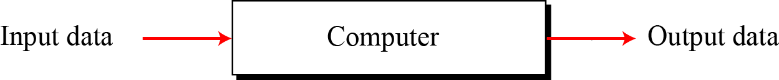
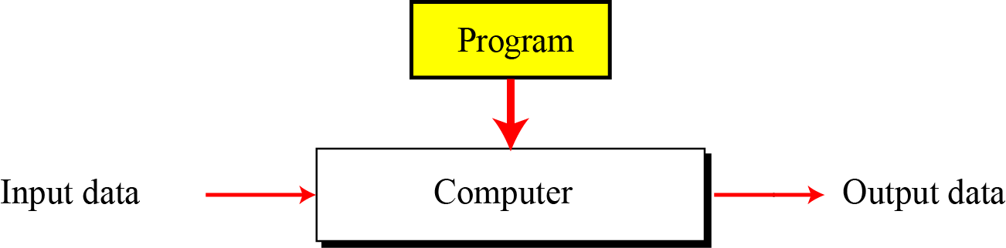
Turing model
Before Turing model
Turing model has an element to the specific computing machine: the program. A program is a set of instructions that tells the computer what to do with data.

Slide 28
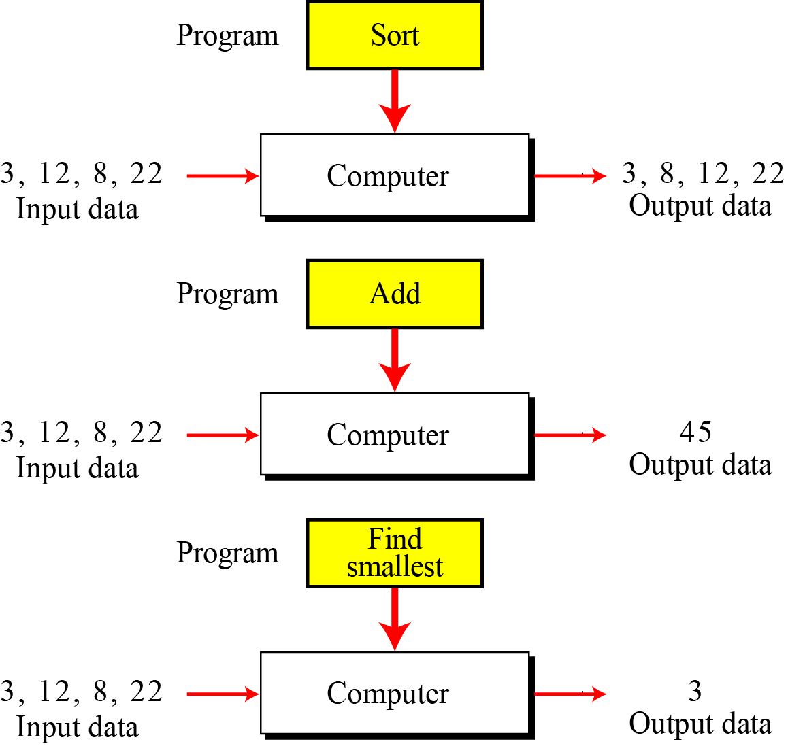
Turing model

Slide 29
Von Neumann model
Computers built on the Turing universal machine store data in their memory.
Around 1944–1945, John von Neumann proposed that, since program and data are logically the same, programs should also be stored in the memory of a computer.

Slide 30
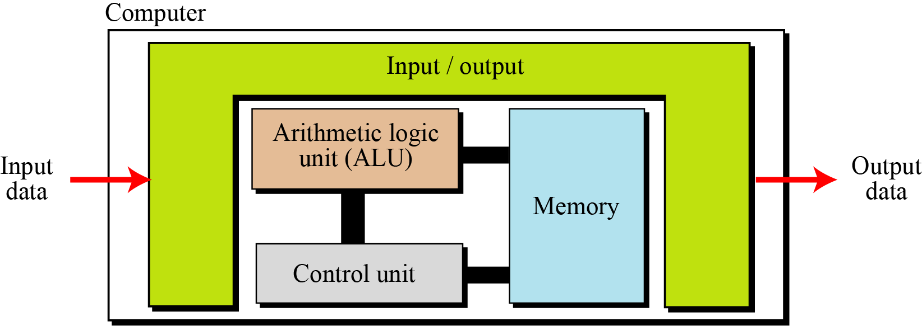
Von Neumann model
Computer hardware divided into four subsystems:
Memory
Arithmetic logic unit
Control unit
Input/Output

Slide 31
Von Neumann model
The von Neumann model states that the program must be stored in memory.
This is totally different from the architecture of early computers in which only the data was stored in memory: the programs for their task was implemented by manipulating a set of switches or by changing the wiring system.
This implies that both the data and programs should have the same format
In fact, they are stored as binary patterns in memory—a sequence of 0s and 1s
Sequential execution of instructions

Slide 32
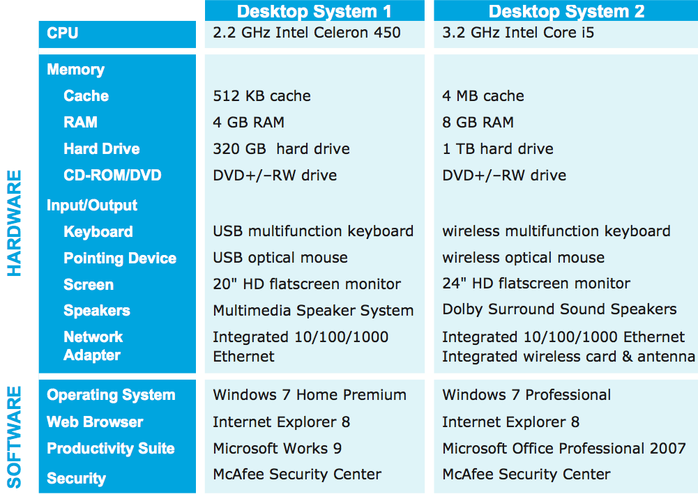
Computer Components
Computer hardware
refers to the physical components of a computer system
e.g., monitor, keyboard, mouse, hard drive
Data
Computer Software
refers to the programs that execute on the computer
e.g., word processing program, Web browser

Slide 33
Machine Languages
Only language computers directly understand
“Natural language” of computer
Defined by hardware design
Machine-dependent
Generally consist of strings of numbers
Ultimately 0s and 1s
Instruct computers to perform elementary operations
One at a time
Cumbersome for humans
Example:
+1300042774 +1400593419 +1200274027

Slide 34
Assembly Languages
English-like abbreviations representing elementary computer operations
Clearer to humans
Incomprehensible to computers
Translator programs (assemblers)
Convert to machine language
Example:
LOAD BASEPAY ADD OVERPAY STORE GROSSPAY

Slide 35
High-level Languages
Similar to everyday English, use common mathematical notations
Single statements accomplish substantial tasks
Assembly language requires many instructions to accomplish simple tasks
Translator programs (compilers)
Convert to assembly language
Interpreter programs
Directly execute high-level language programs
Example:
grossPay = basePay + overTimePay

Slide 36
Programming Approaches
Structured programming (1960s)
Disciplined approach to writing programs
Clear, easy to test and debug, and easy to modify
Focus on what the program does
Object Oriented programming
Object is an entity characterized by a state and a behavior
state is encoded in the computer program as data
behavior is encoded as methods

Slide 37
History
Before 1930s
In the 17th century, Blaise Pascal (French mathematician and philosopher) invented Pascaline.
Leibnitz’ Wheel by Gottfried Leibnitz
Jacquard loom by Joseph-Marie Jacquard
Difference Engine and Analytical Engine by Charles Babbage

Slide 38
History
The birth of electronic computers (1930–1950)
ABC
Z1
Mark I.
Colossus
ENIAC

Slide 39
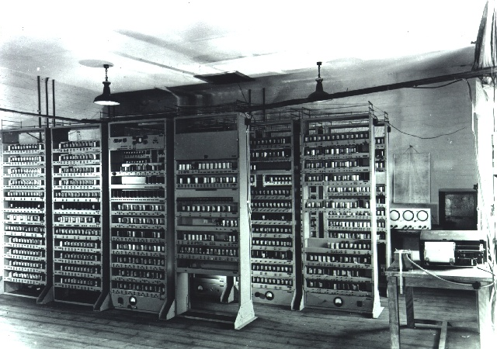
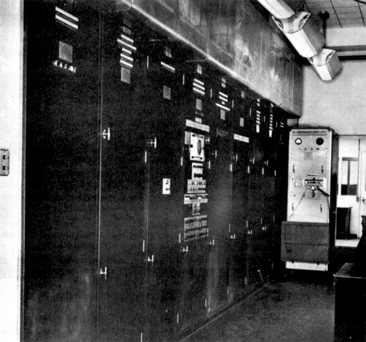
History
Computers based on the von Neumann model (1950)
EDVAC at the University of Pennsylvania
EDSAC by Maurice Wilkes at Cambridge University
The EDVAC (1946-52)
The EDSAC (1947-49).

Slide 40
History
The first generation (roughly 1950–1959) is characterized by the emergence of commercial computers.
Second-generation computers (roughly 1959–1965) used transistors instead of vacuum tubes. Two high-level programming languages, FORTRAN and COBOL invented and made programming easier.
The third generation: The invention of the integrated circuit reduced the cost and size of computers even further. Minicomputers appeared on the market. Canned programs, popularly known as software packages, became available. This generation lasted roughly from 1965 to 1975.

Slide 41
History
The fourth generation (approximately 1975–1985) saw the appearance of microcomputers. The first desktop calculator, the Altair 8800, became available in 1975. This generation also saw the emergence of computer networks.
This open-ended generation started in 1985. It has witnessed the appearance of laptop and palmtop computers, improvements in secondary storage media (CD-ROM, DVD and so on), the use of multimedia, and the phenomenon of virtual reality.

